Slide 1
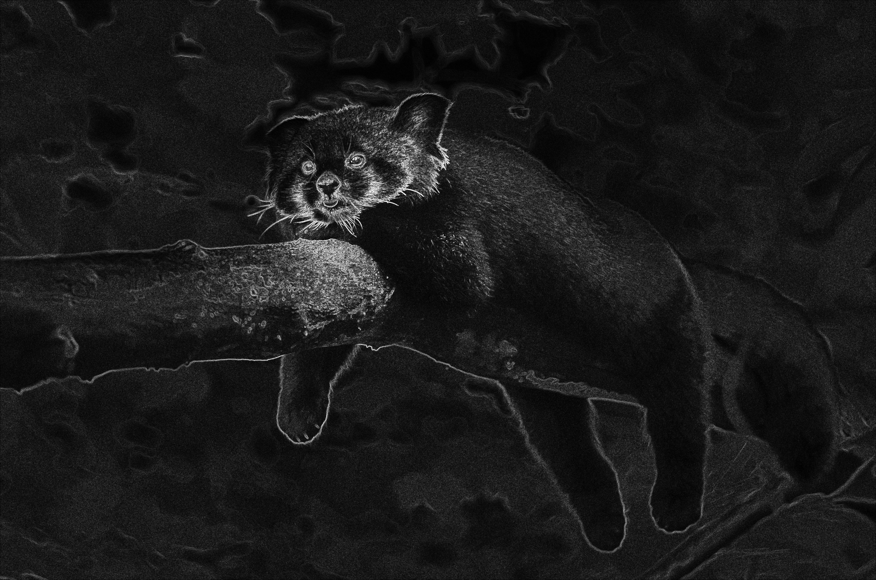
Multicore & GPU Computing
Bild Verarbeitung : Sobel Operator
Gruppe 1: Arno Chaidron, Louis Hermier

Slide 2
Agenda
Test-Daten
Prototypen
OpenMP Parallelisierung
CUDA Parallelisierung

Slide 3

Test-Daten
Small: 600 * 397 = 238 200px
Medium: 1000 * 662 = 662 000px (2,8x small)
Large: 4394 * 2910 = 12 786 540px (19x medium, 54x large)

Slide 4
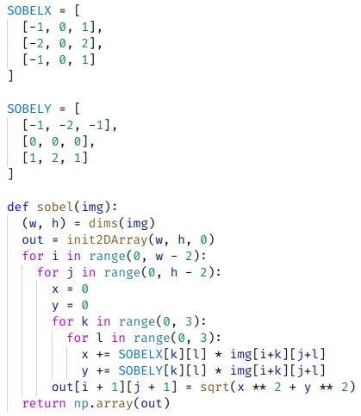
Python Prototyp
Timings:
Small: 7217 ms (~ 7 s)
Medium: 20309 ms (~ 20 s)
Large: 387394 ms (~ 387 s, ~ 6 m 30 s)

Slide 5
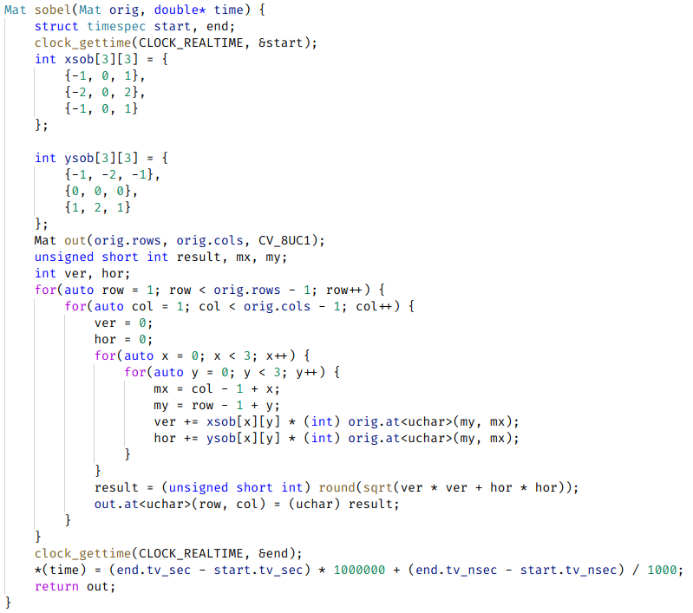
C++ Prototyp
Timings:
Small: 16 ms (15757 µs)
Medium: 44 ms (43910 µs)
Large: 879 ms (879086 µs)

Slide 6
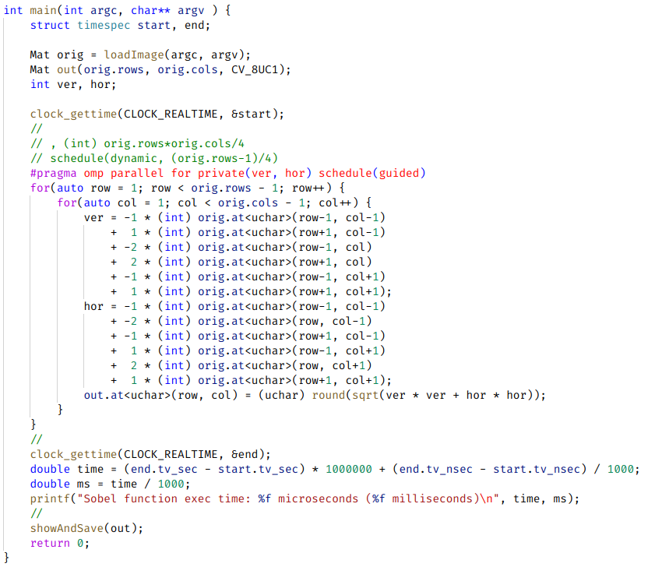
OpenMP Parallelisierung
Timings:
Small: 21 ms (20766 µs)
Medium: 3 ms (2865 µs)
Large: 50 ms (50094 µs)
Speedup:
Small: 0,8x
Medium: 14,7x
Large: 17,6x

Slide 7
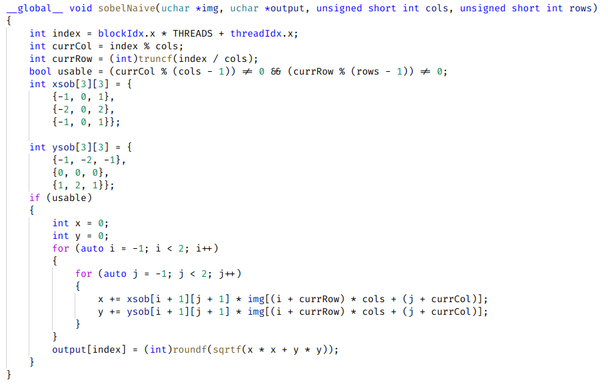
CUDA Parallelisierung: Naive Implementierung
Timings:
Small: 0,047 ms (47 µs)
Medium: 0,127 ms (127 µs)
Large: 1,169 ms (1169 µs)
Speedup:
Small: 340,4x
Medium: 346,5x
Large: 751,9x

Slide 8
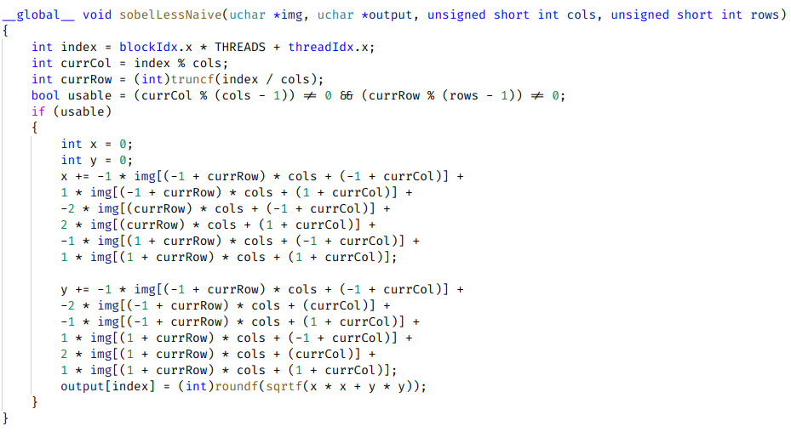
CUDA Parallelisierung: Erste Optimierung
Timings:
Small: 0,046 ms (46 µs, -1µs)
Medium: 0,120 ms (120 µs, -7µs)
Large: 1,153 ms (1153 µs, -16µs)

Slide 9
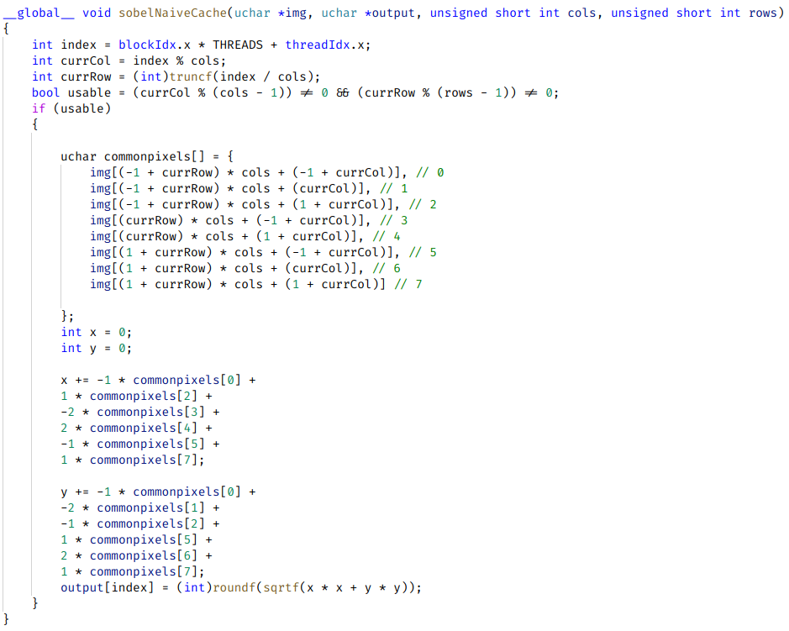
CUDA Parallelisierung: Lade alle werte gleichzeitig
Timings:
Small: 0,045 ms (45 µs, -1µs)
Medium: 0,116ms (116µs, -4µs)
Large: 1,157 ms (1157 µs, +4µs)

Slide 10
CUDA Parallelisierung: Profiling
Compute: 47,9% Memory: 25,8%
Threads (Large): 12486 * 1024 = 12 785 664

Slide 11
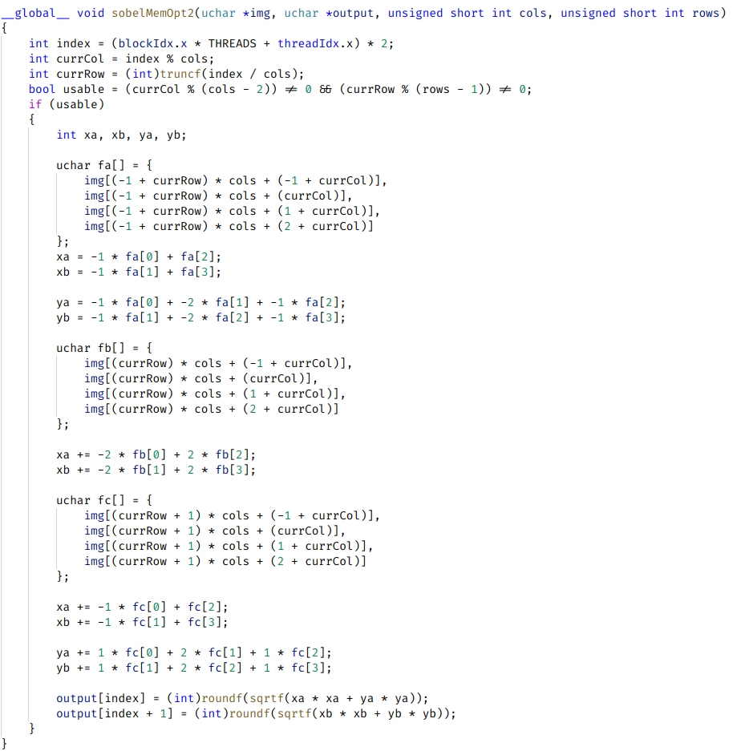
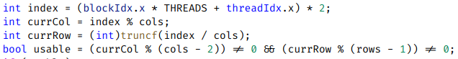
CUDA Parallelisierung: 2 pixels pro thread
Timings:
Small: 0,042 ms (42 µs, -5 µs)
Medium: 0,096 ms (96 µs, -31 µs)
Large: 0,723ms (723µs, -446 µs)
Speedup (Relativ zum Naive GPU Lösung):
Small: 1,1x
Medium: 1,3x
Large: 1,6x

Slide 12
CUDA Parallelisierung: 2 pixels pro thread (profiling)
Compute: 51,3% Memory: 32,7%
Threads (Large): 6243 * 1024 = 6 392 832

Slide 13
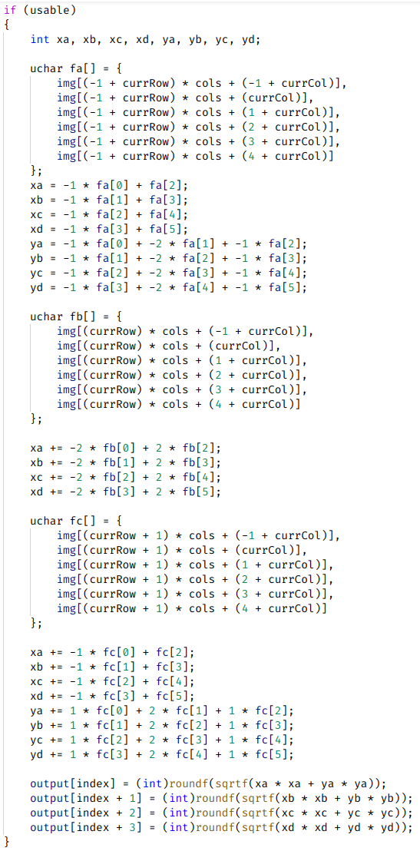
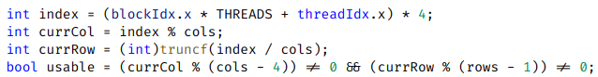
CUDA Parallelisierung: 4 pixels pro thread
Timings:
Small: 0,038 ms (38 µs, -9 µs)
Medium: 0,085ms (85µs, -42 µs)
Large: 0,512 ms (512 µs, -657 µs)
Speedup (Relativ zum Naive GPU Lösung):
Small: 1,2x
Medium: 1,5x
Large: 2,3x

Slide 14
CUDA Parallelisierung: 4 pixels pro thread (profiling)
Compute: 53,2% Memory: 38,45%
Threads (Large): 3120 * 1024 = 3 194 880

Slide 15
CUDA Parallelisierung: 4 pixels pro thread (Anzahl an Threads pro Block)
Timings (Large):
1024 Threads: 490µs (Compute throughput: 53,2%, Memory Throughput: 38,5%)
512 Threads: 336µs (Compute throughput: 77,4%, Memory Throughput: 56,0%)
256 Threads: 314µs (Compute throughput: 82,9%, Memory Throughput: 60,0%)
128 Threads: 310µs (Compute throughput: 84,1%, Memory Throughput: 60,8%)
64 Threads: 334µs (Compute throughput: 78,1%, Memory Throughput: 56,4%)
32 Threads: 496µs (Compute throughput: 52,5%, Memory Throughput: 38,0%)
Timings (128 Threads):
Small: 0,0095 ms (9,5 µs, -35,5 µs)
Medium: 0,0206ms (20,6 µs, -95,4 µs)
Large: 0,310 ms (310 µs, -847 µs)
Speedup (Relativ zum Naive GPU Lösung):
Small: 4,7x
Medium: 5,6x
Large: 3,7x

Slide 16
Cuda Parallelisierung: Final Speedup
Timings (C++ Prototyp):
Small: 16 ms (15757 µs)
Medium: 44 ms (43910 µs)
Large: 879 ms (879086 µs)
Speedup:
Small: 1658,7x
Medium: 2131,6x
Large: 2835,8x
Timings (CUDA):
Small: 0,0095 ms (9,5 µs)
Medium: 0,0206ms (20,6 µs)
Large: 0,310 ms (310 µs)

Slide 17
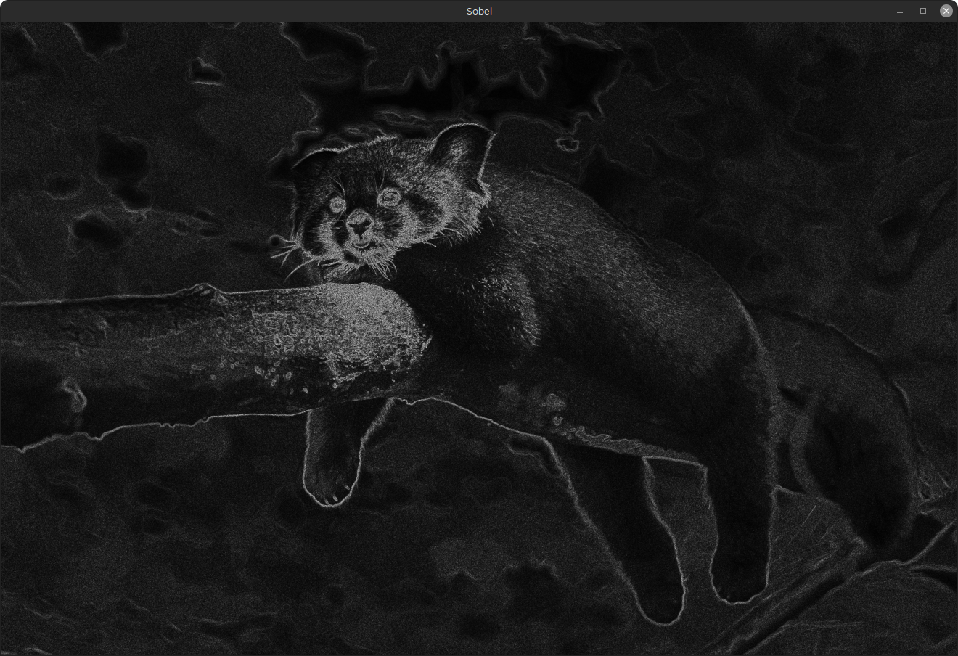
Vorführung

Slide 18
Fazit

Slide 19
Fragen?

